Slide 1

Cracking the Code
A Machine Learning Approach to Credit Card Lead Prediction
Presented by: Dinesh Chenaramchowdary

Slide 2
TABLE OF CONTENTS
01
06
Problem Statement
Model Building and Evaluation
02
07
Significance of Credit Card Lead
Hyperparameter Tuning
03
08
Process of Model Building
Important Features for Prediction
04
09
Exploratory Data Analysis
Results and Future Directions
05
10
Data Preprocessing
Q & A

Slide 3
Problem Statement
Challenges
Data Complexity and Volume
Problem Statement
Goals and Objective
Develop a Predictive model for detection of customers for Credit card
The problem at hand is to develop a predictive model that accurately predicts potential customers to offer credit card.
Dynamic Customer Behaviour
Utilizing machine Learning to analyze customer behaviour patterns and insights
Targeting Right Customers

Slide 4
Significance of Credit Card Lead
Credit Card
Lead
Customer Acquisition
Revenue Generation
Risk Management
Credit card lead prediction is highly valuable for banking institutions, enabling customer acquisition, revenue generation, and risk management
Banks encounter the challenge of identifying the ideal customers who are likely to adopt credit card products and become valuable long-term clients
Accurate credit card lead prediction optimizes marketing efforts, improves conversion rates, reduces costs, and maximizes return on investment
By leveraging credit card lead prediction, banks can drive business growth, enhance customer satisfaction, build long-term relationships, and foster loyalty

Slide 5
Process of Model Building
Data Selection and Tools
Selecting data relevant to use case (Customer information in bank).
Data Engineering
Steps Involving data cleaning, preprocessing, and transformation
Exploratory Data Analysis
Understanding the dataset and Identifying key insights, patterns and trends
Model Creation
Training various classification models for use case
Model Evaluation
Evaluating the performance of Model from various evaluation metrics

Slide 6

Dataset Source and Overview
The dataset used for this project is retrieved from Analytics Vidhya Job-a-thon challenges to find the credit card lead.
https://www.analyticsvidhya.com/
Comprehensive dataset with various customer attributes.
Factors include age, gender, Region code, Occupation, Channel Code, Vintage, Credit Product, Average Account Balance, etc.
Uncovering hidden patterns to predict Credit Card Lead

Slide 7
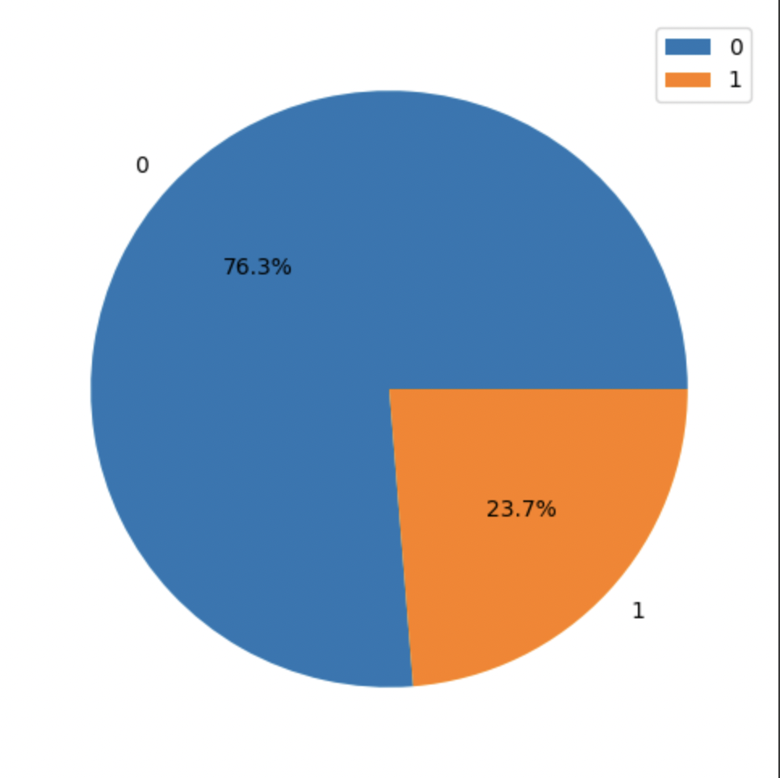
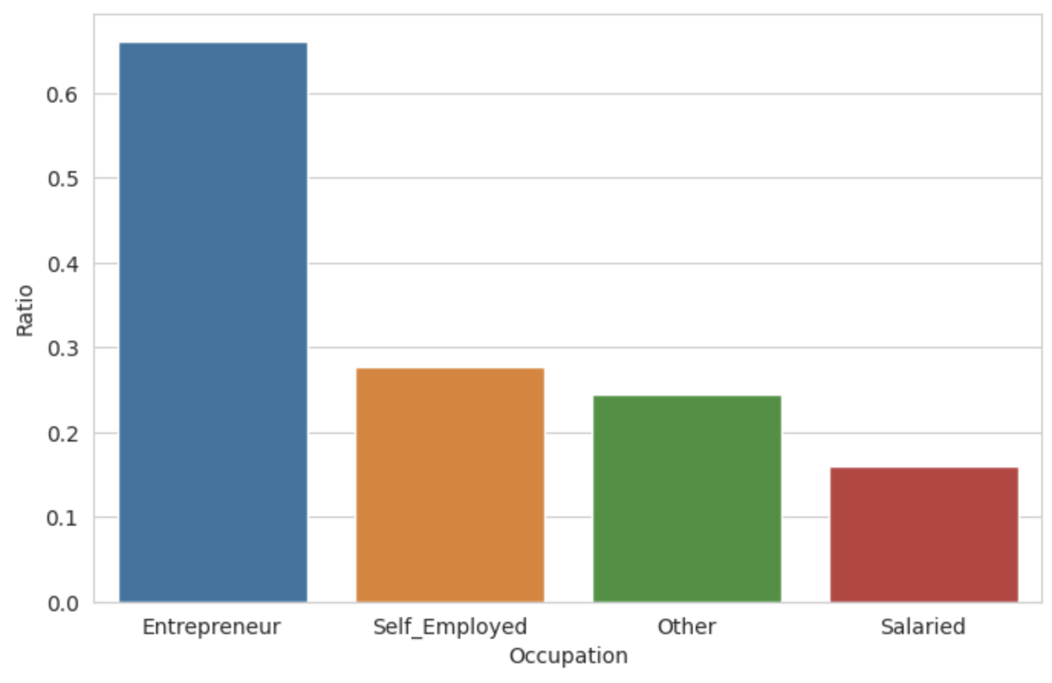
Exploratory Data Analysis
Target variable distribution
Feature Occupation Interaction
The above pie chart represents the distribution of target further analyze that there is class imbalance
From the above plot we can deduce that lot of customers occupation is Entrepreneur or Self Employed as per the data

Slide 8
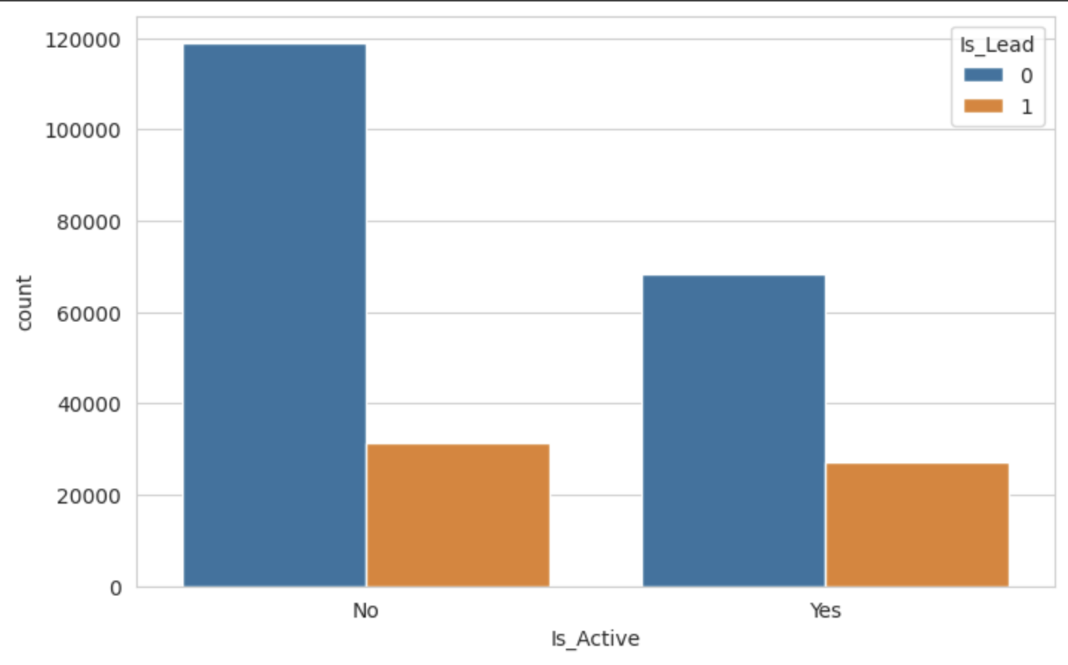
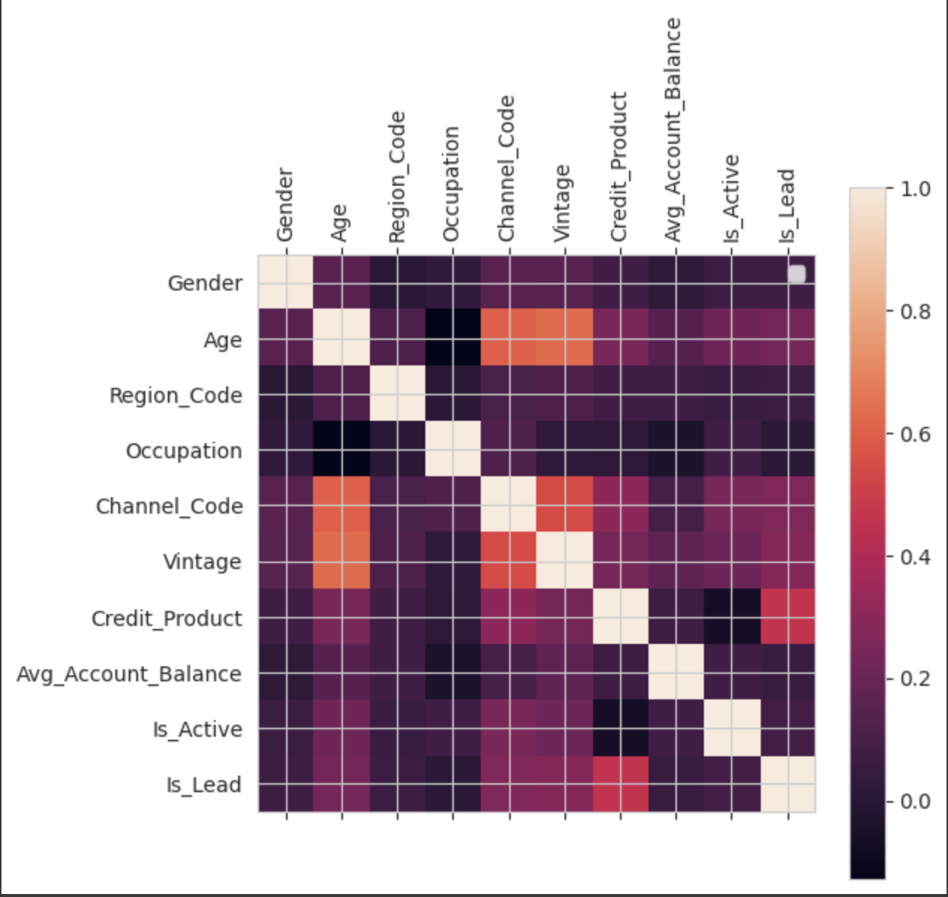
Exploratory Data Analysis
Feature Is_Active vs Target Interaction
Correlation Analysis
The above plot represents that there are lot of Customers who are Inactive at the same time

Slide 9
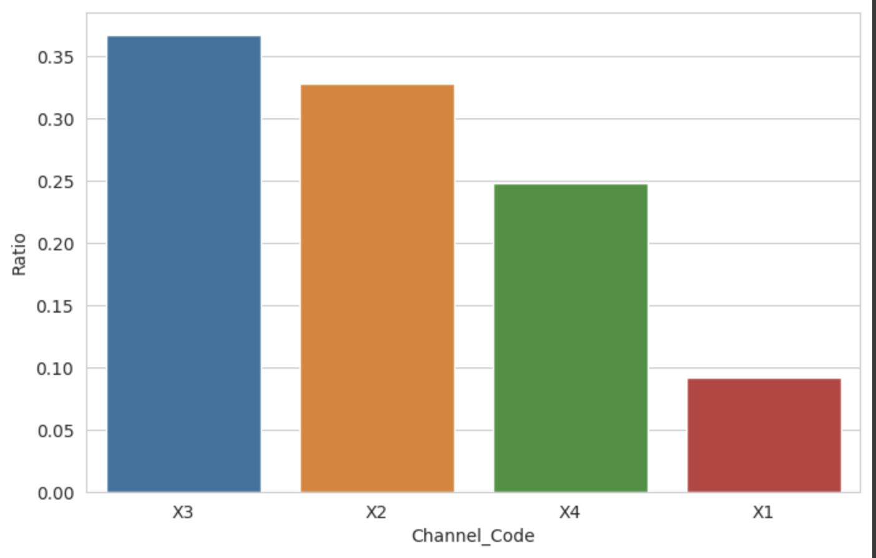
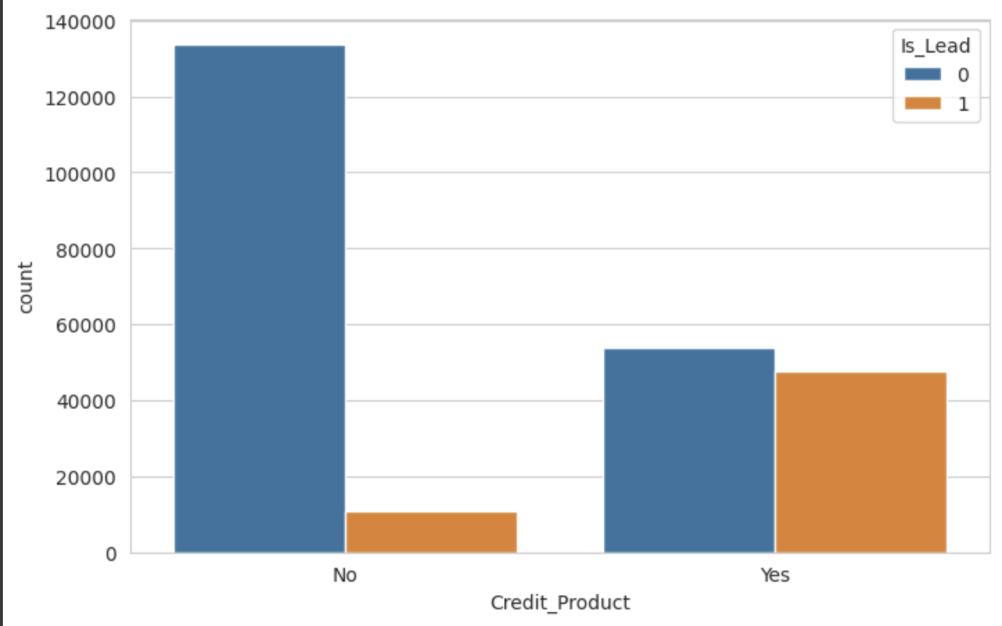
Exploratory Data Analysis
Feature Credit Product Target Interaction
Feature Channel Code Interaction
The above plot shows that as per the data there are lot of customers who don’t have any credit product with the bank
The above plot shows the channel code distribution as per the data

Slide 10

Tools and Techniques

Slide 11
Data Cleaning & Preprocessing
Credit Product (filled NULL with a new class)
Cleaning
Label Encoder
Applied for categorical variables
Credit Card Lead Prediction
Encoding
Using Standardization
Avg_Account_Balance
Vintage
Age
Scaling
Log Transformation
Distributed Region code

Slide 12
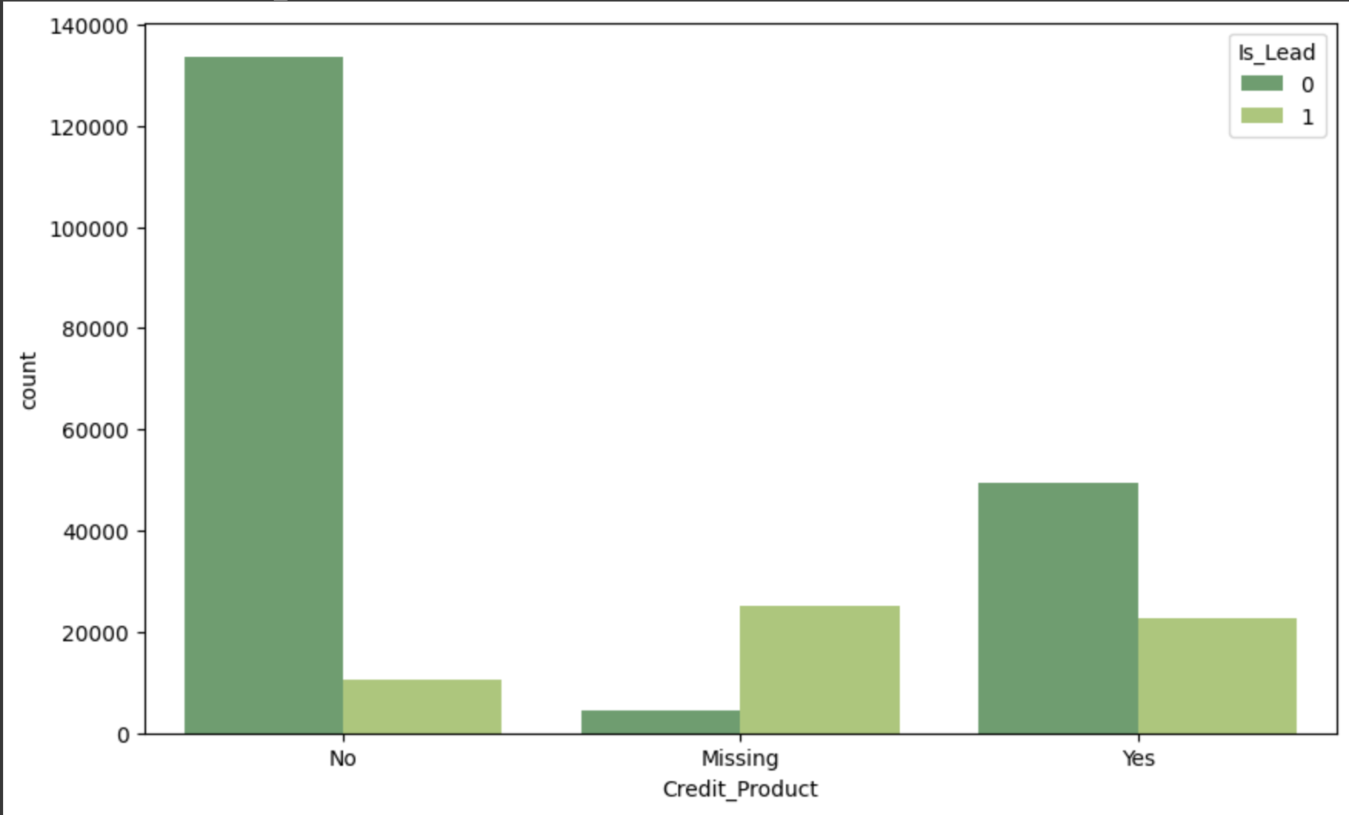
Data Cleaning
Class distribution in the previous iteration
Class distribution of missing values: Added new class called “Unknown” to the feature

Slide 13
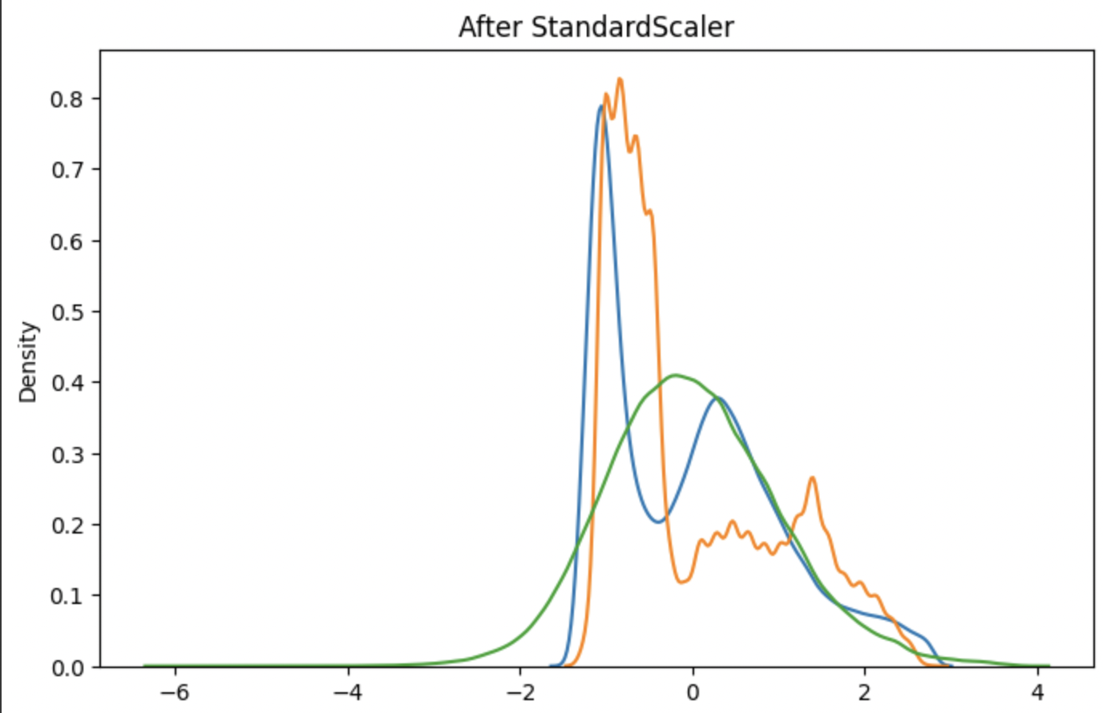
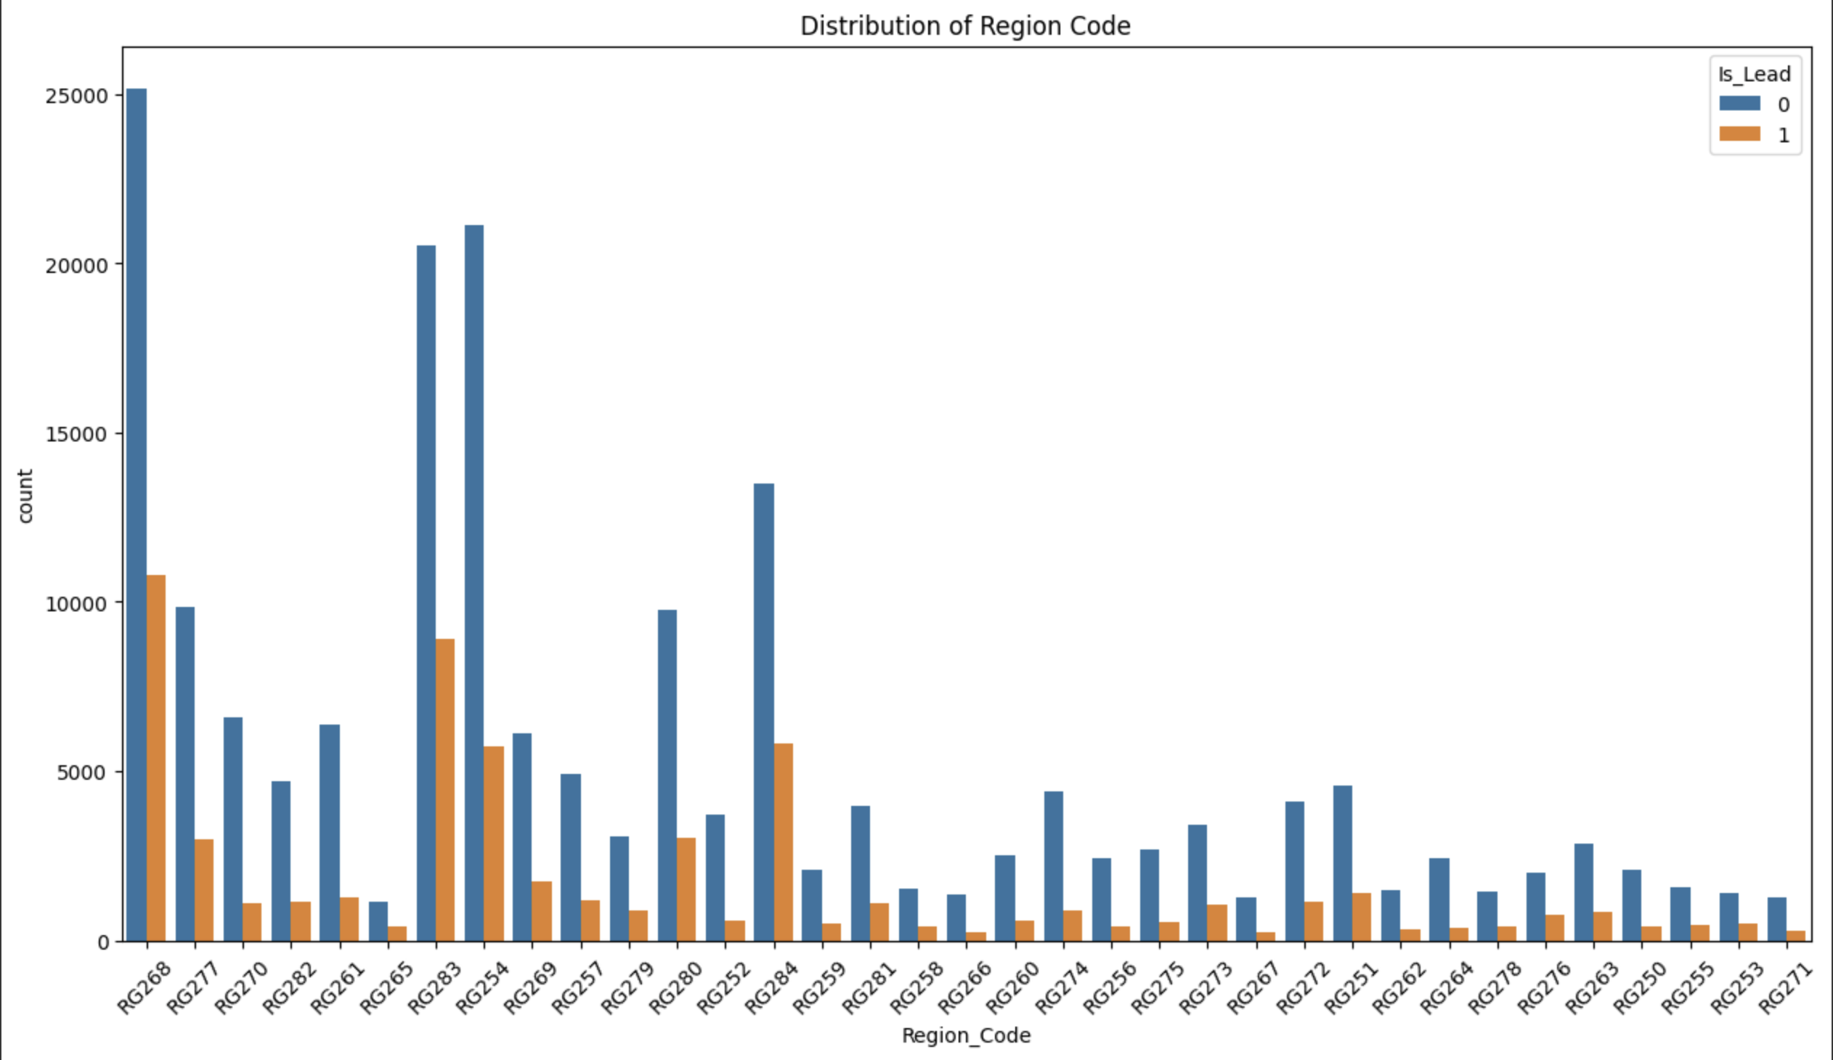
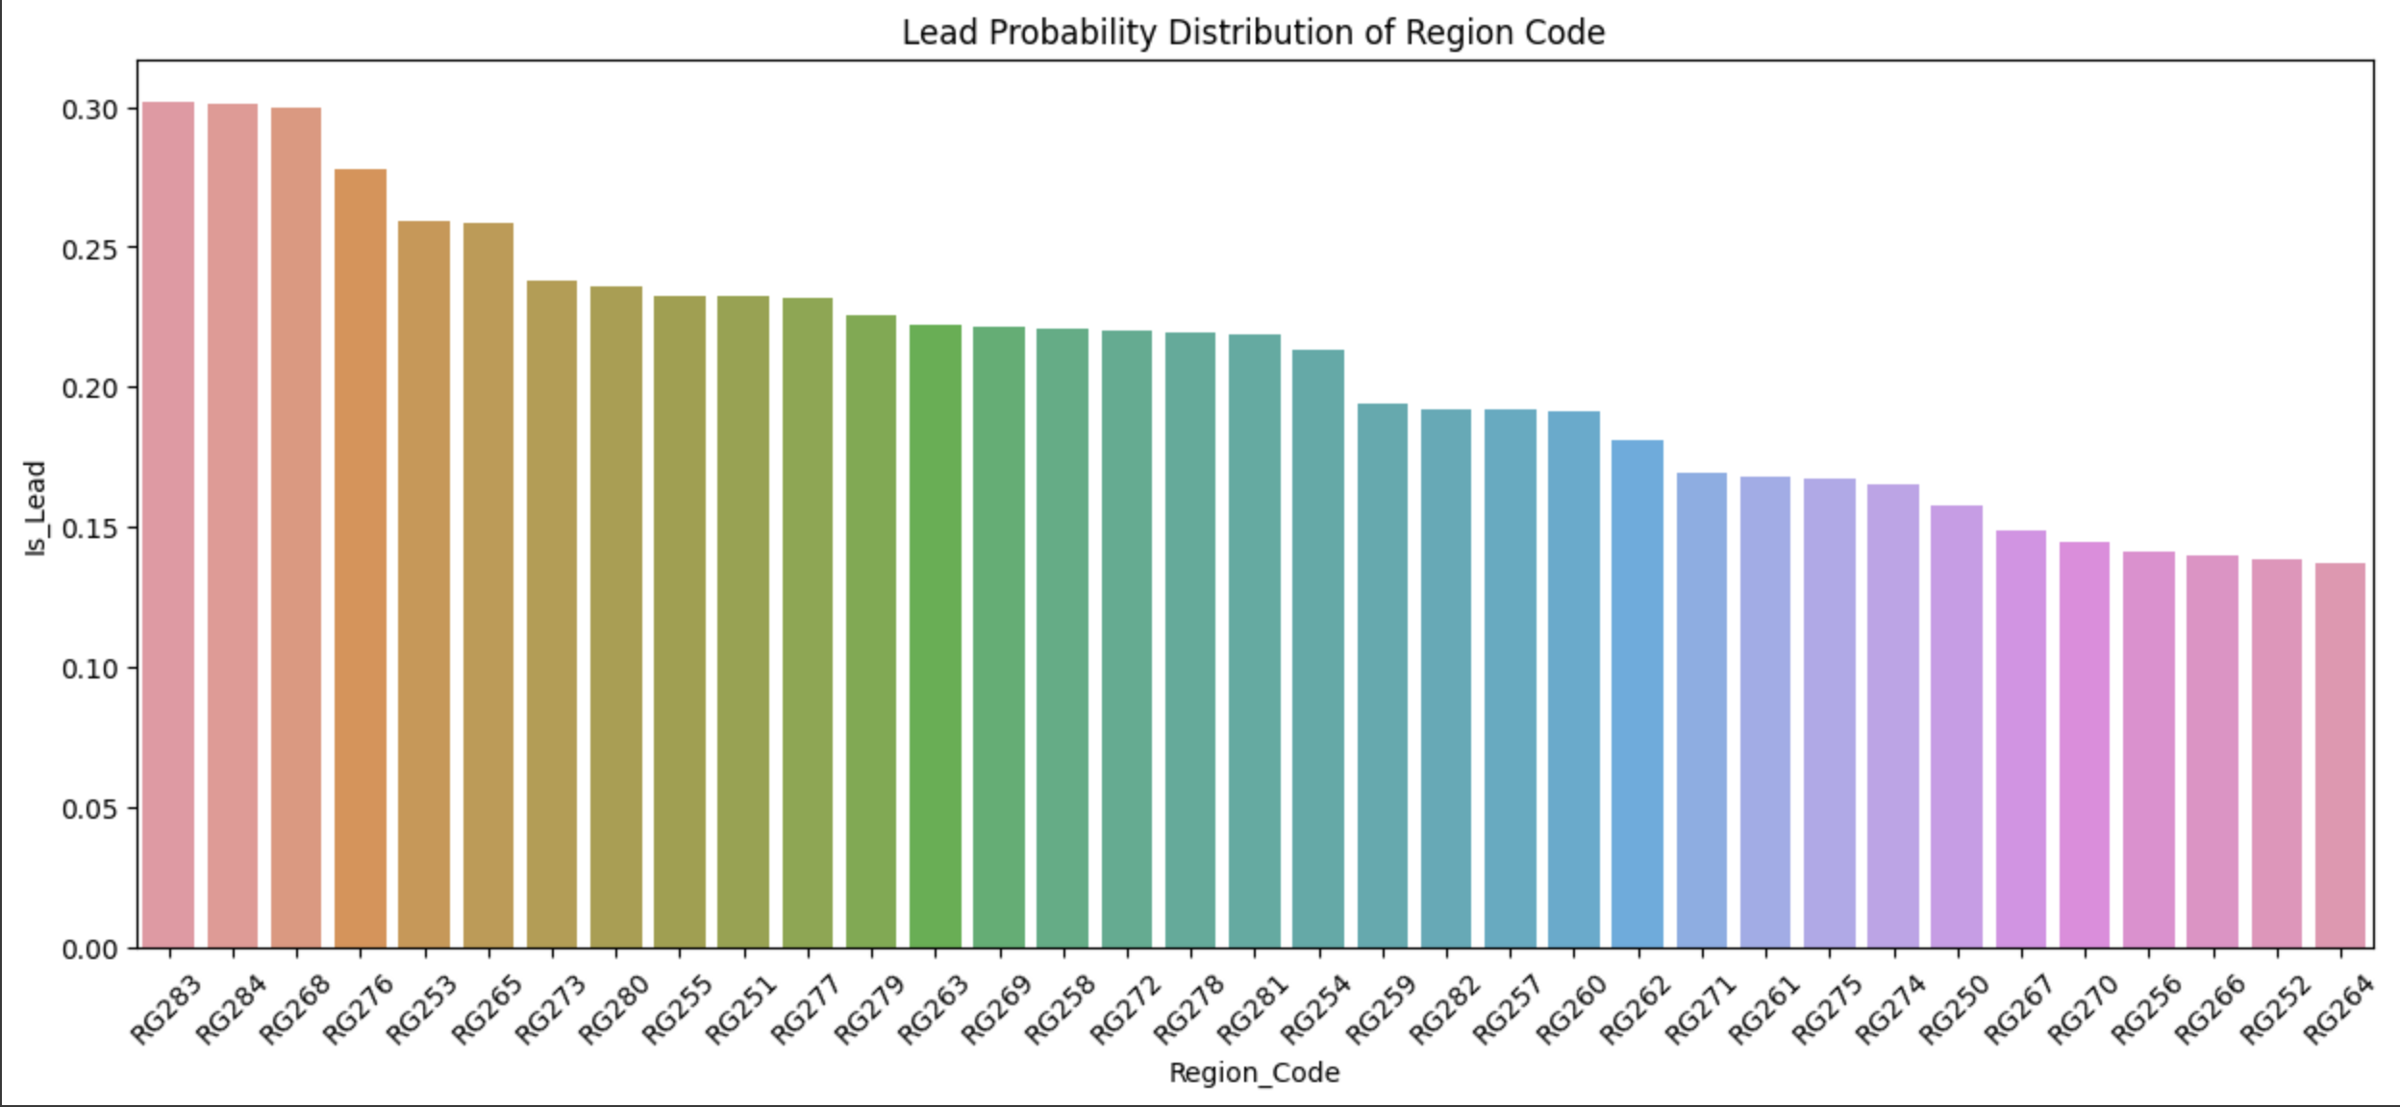
Feature Scaling and Normalization
Scaling Technique
Applied standard scaling to numerical variables such as Age, Vintage, and Avg_Account_Balance.
Normalized the numerical variables, preventing any feature from dominating the model's predictions.
Transformation Technique
To address long tail skewed distribution in the ”Region_Code" column. Normalized the numerical variables.
probability_score = no_of_leads_in_region / no_of_customers_in_region
Helped to normalize the data and creating more balanced distribution and improved the model's capacity to identify patterns

Slide 14
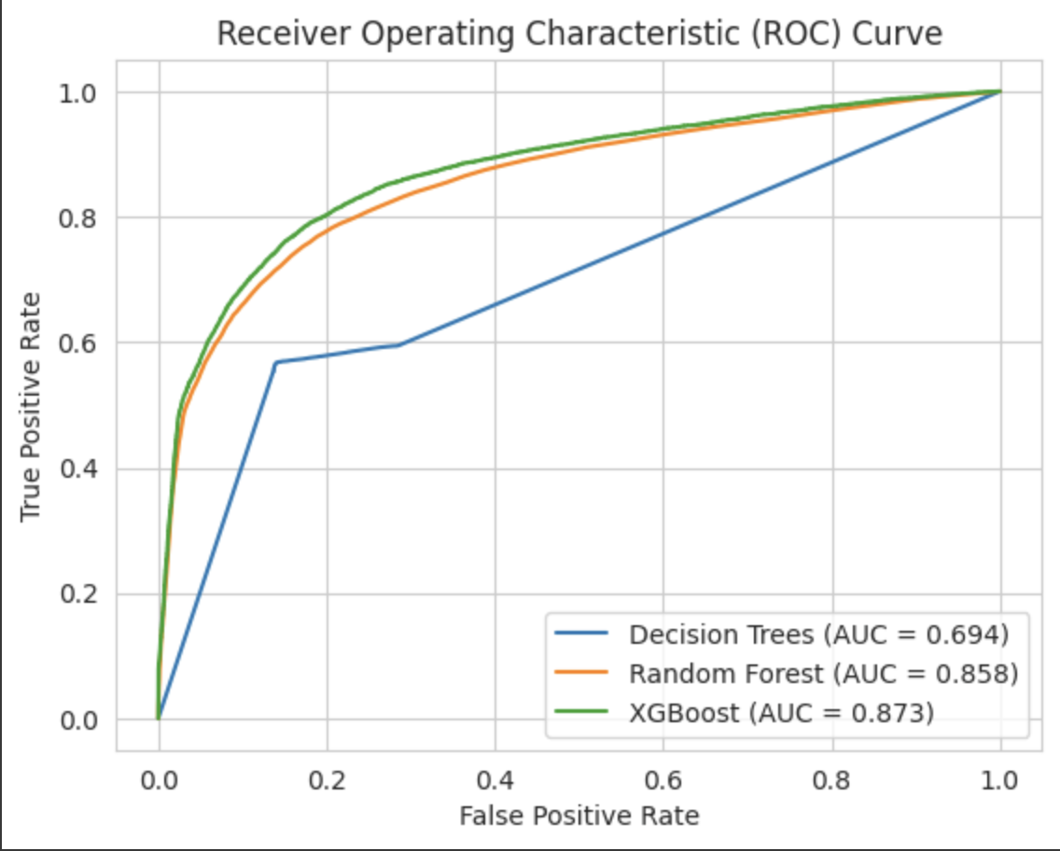
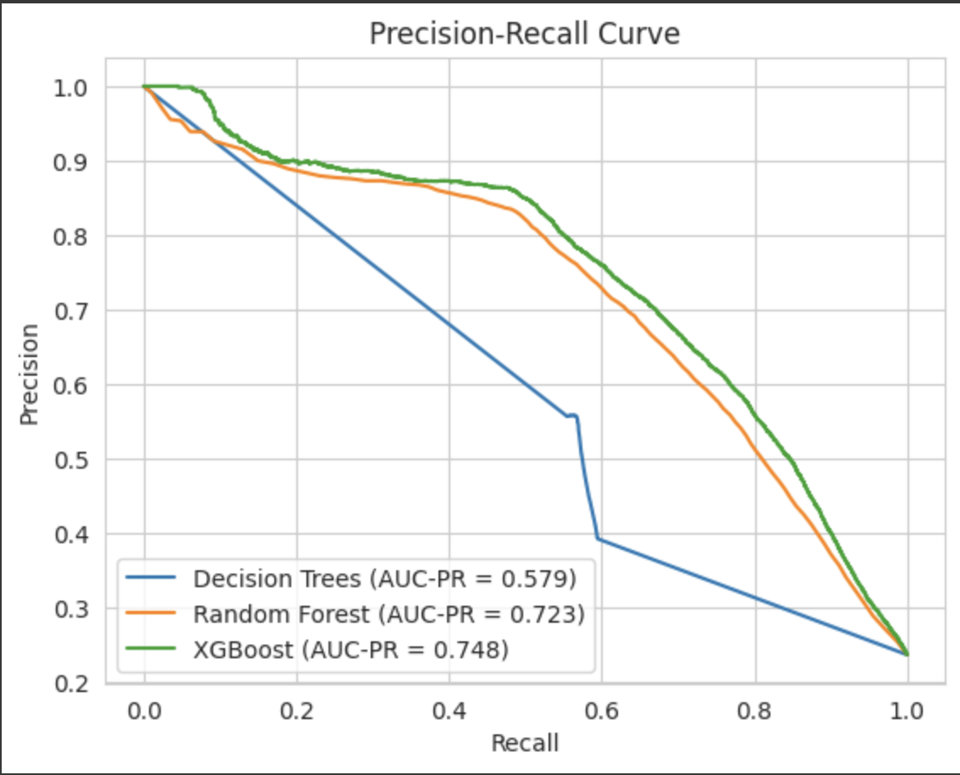
Model Building and Evaluation
Base Model
Trained Various classification model on the dataset
Model Metrics |  | Decision Tree | Random Forest | XGBoost
Accuracy |  | 0.790 | 0.854 | 0.860
Recall |  | 0.562 | 0.578 | 0.559
Precision |  | 0.557 | 0.748 | 0.792
F1score |  | 0.560 | 0.652 | 0.655
From the above evaluation metrics, we can see that Random forest and XGBoost is performing decently with Accuracy, and precision than Decision Trees
The recall is relatively low for all the models which is indicating some missed positive cases.
By seeing the AUC on ROC graph Random Forest and XGBoost models had a decent Area under the curve.
The precision recall curve shows the models behaving worse in precision and recall metrics.

Slide 15
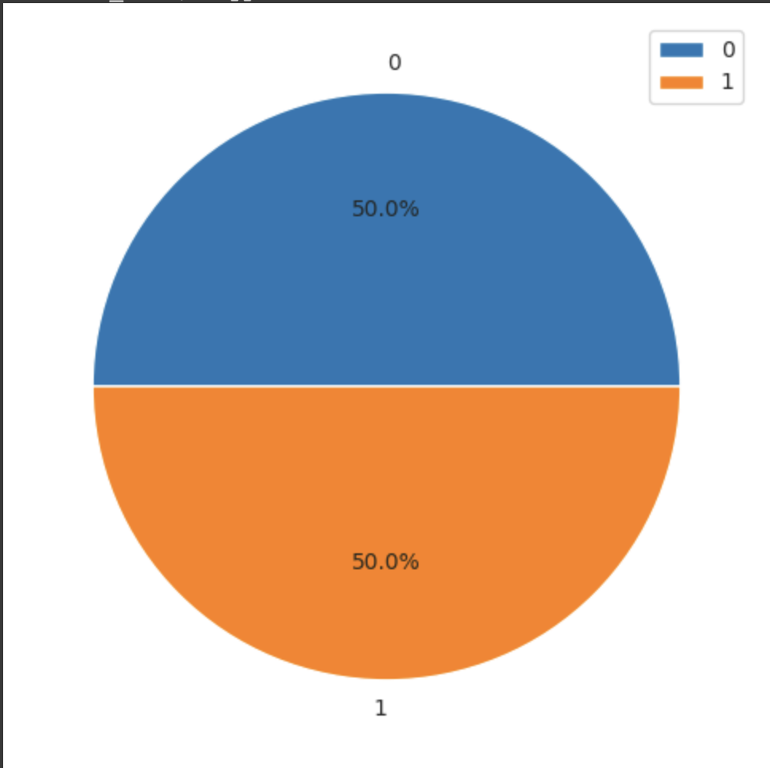
Class Imbalance
Synthetic Minority Oversampling Technique(SMOTE)
Used to address the target variable's class imbalance problem
Before SMOTE
0: people who are not likely to accept the offer
1: people who are likely to accept the offer.
76% of people are not likely to accept the offer
23% of people are likely to accept it
After SMOTE
The class distribution is made equal
Successfully addressed the class imbalance issue

Slide 16
Hyperparameter Tuning
The below are the best Hyperparameters for the models retrieved after optimization
Classification Models | Best Hyperparameters
Decision Tree | max_depth: 14, min_samples_split=8, random_state=42
Random Forest | 'n_estimators': 167, 'max_depth': 30
XGBoost | 'n_estimators': 244, 'max_depth': 23, 'learning_rate': 0.04935729572676165, 'subsample': 0.24224833789044778, 'colsample_bytree': 0.27400884726795643, 'reg_alpha': 3.3612527284800215, 'reg_lambda': 7.220262350084212

Slide 17
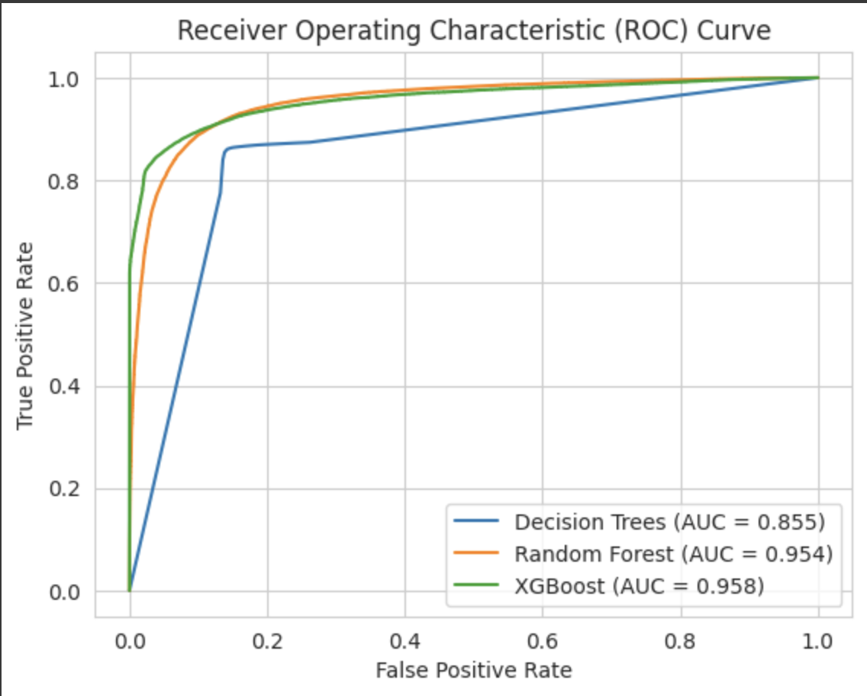
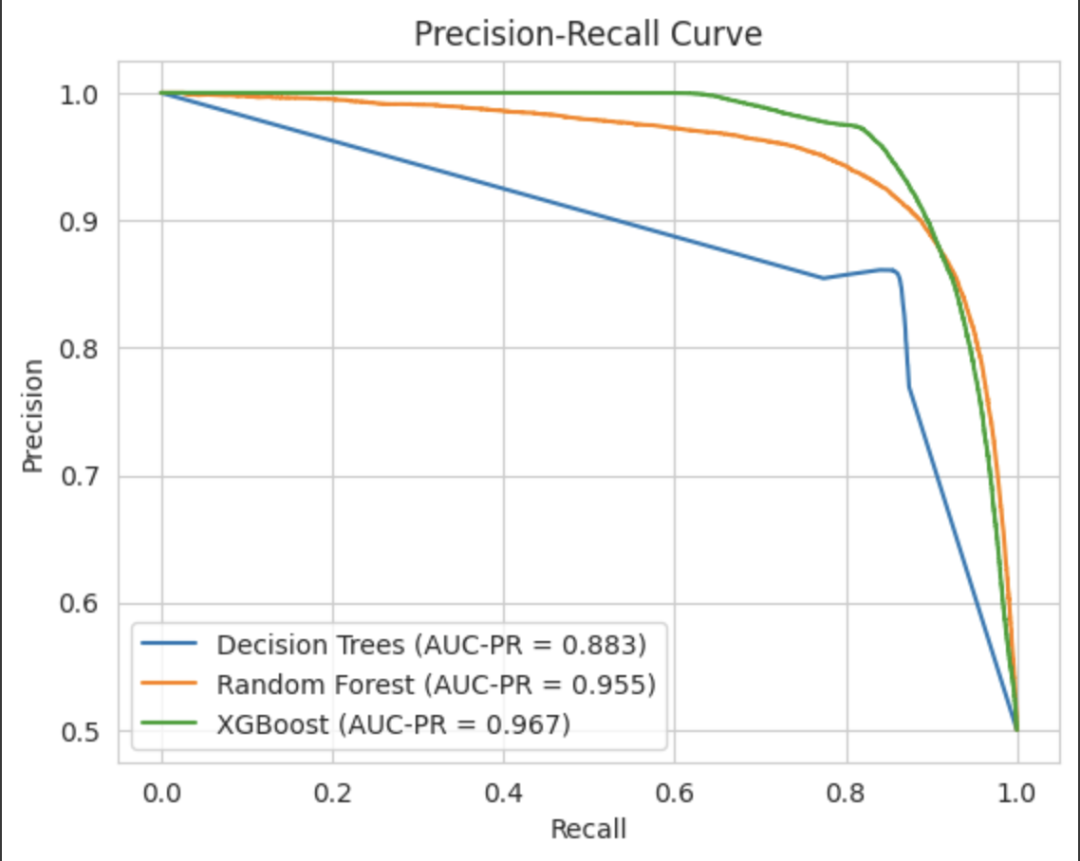
Model Building and Evaluation
Performance Tuned Model
Fixed Class Imbalance Issue
Performed Hyperparameter Tuning using Optuna
Model Metrics |  | Decision Tree | Random Forest | XGBoost
Accuracy |  | 0.860 | 0.894 | 0.903
Precision |  | 0.825 | 0.890 | 0.869
Recall |  | 0.887 | 0.896 | 0.944
F1score |  | 0.855 | 0.893 | 0.899
From the above evaluation metrics, we can see that metrics indicate improved performance compared to the previous results.
Model shows better accuracy in predicting the target variable
By seeing the AUC on ROC graph Random Forest and XGBoost models has a good Area under the curve which shows these models do a good job in predicting lead for Credit card.
The precision recall curve shows the XGB and Random Forest models shows good performance in both precision and recall, indicating a better balance in correctly identifying positive cases

Slide 18
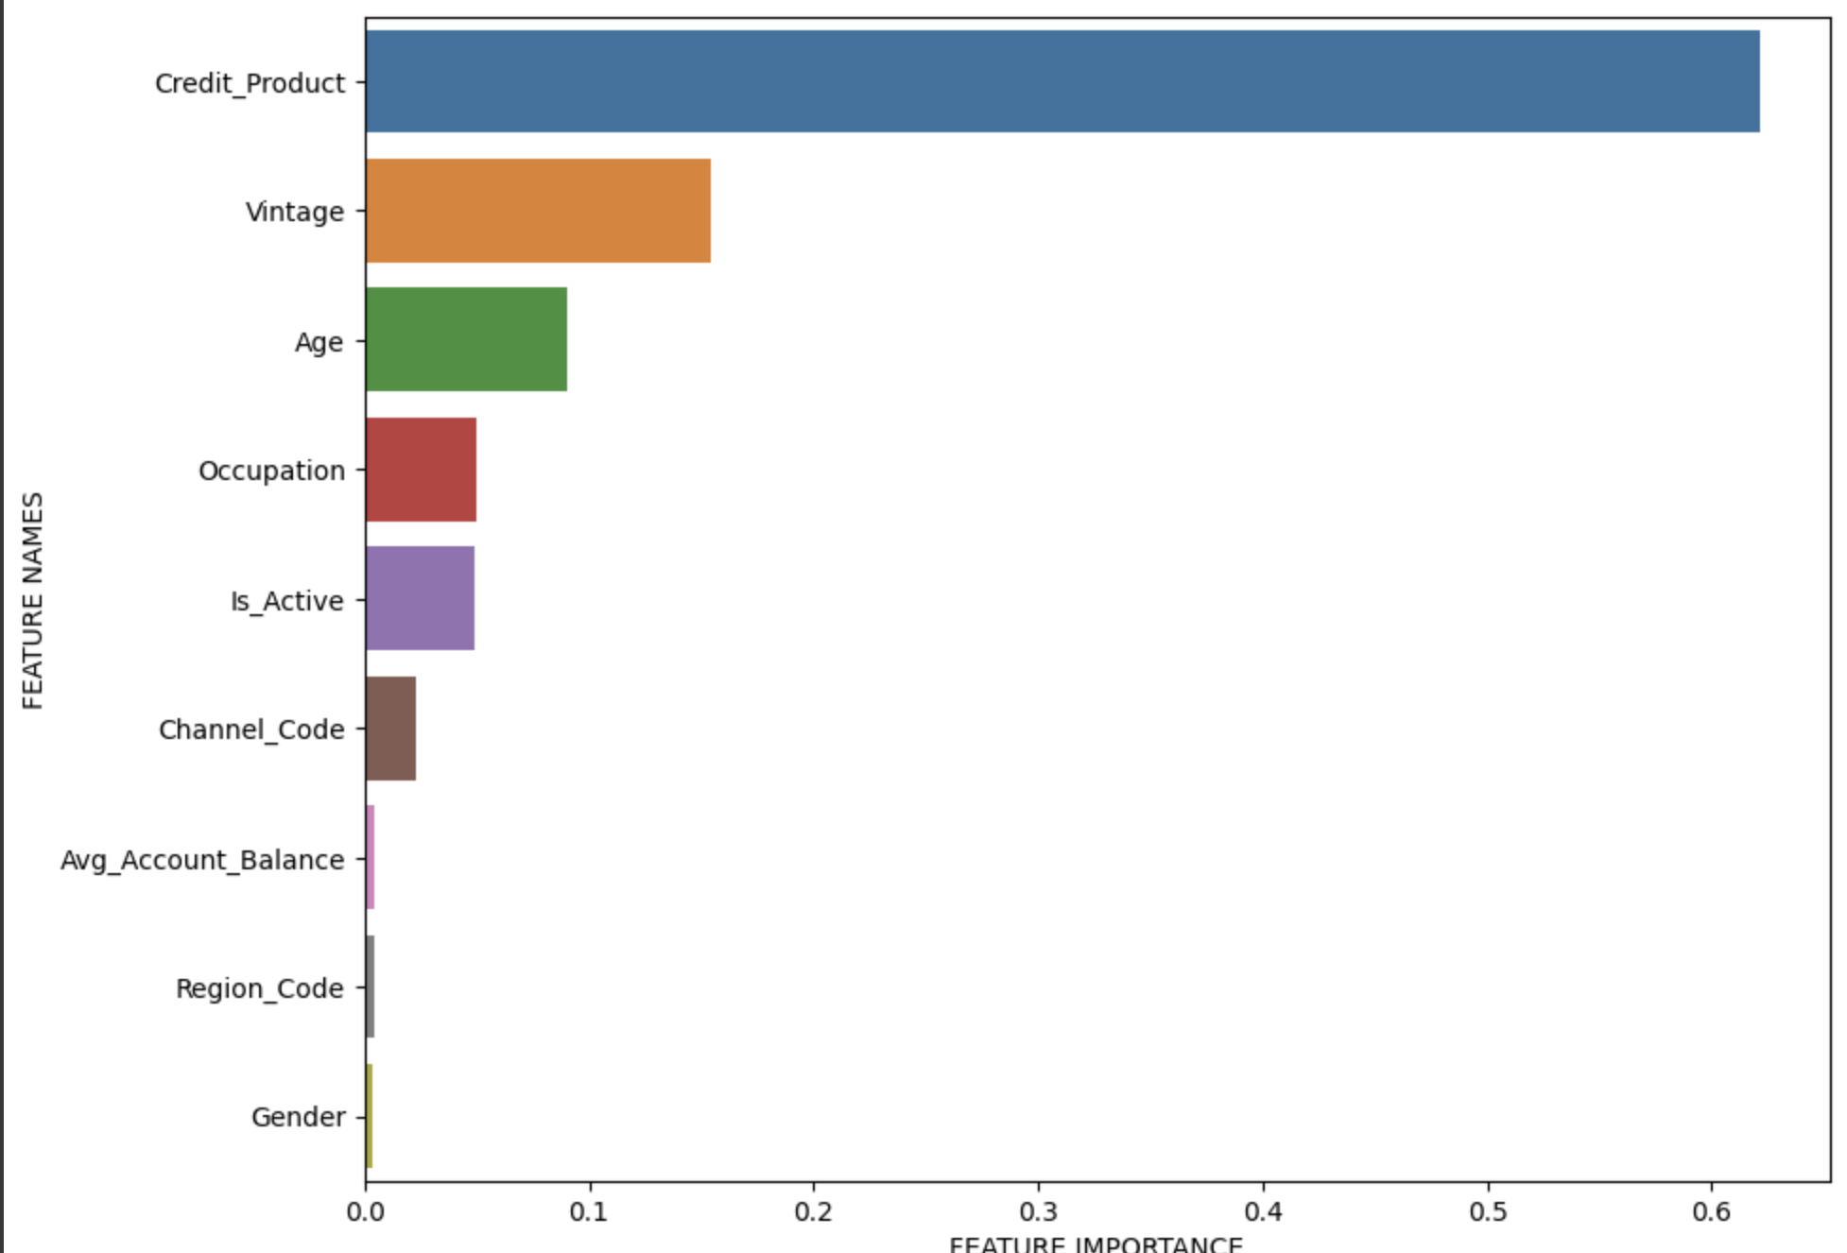
Important Features in Credit Card Lead Prediction
The below plot shows the top 10 important features as per Random Forest Model

Slide 19

Results and Future Directions
The Credit Card Lead prediction Model has yielded promising results
After careful evaluation and hyperparameter tuning using Optuna, we achieved high accuracy and robust performance across different models
Continuously refine and expand the feature set to capture more nuanced patterns
Collect more diverse samples and more data samples related to customers to keep on training the model on unseen data points
This Photo by Unknown Author is licensed under CC BY-ND

Slide 20
REFERENCES
Analytics Vidhya. (n.d.). Analytics Vidhya | Learn everything about Data Science, Artificial Intelligence and Web 3.0. https://www.analyticsvidhya.com/
GeeksforGeeks. (2022). Hyperparameter tuning. GeeksforGeeks. https://www.geeksforgeeks.org/hyperparameter-tuning/
Engel, A. (2022, March 12). Three Techniques for Scaling Features for Machine Learning. Medium. https://towardsdatascience.com/three-techniques-for-scaling-features-for-machine-learning-a7bc063ecd69

Slide 21

THANK YOU

